Slide 1
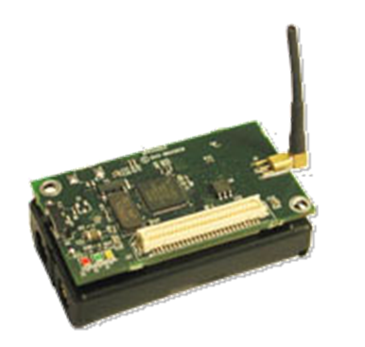
Johnson Lee
September 27th, 2006
Prepared For:
Department of Computing, Hong Kong Polytechnic University

Slide 2
Outline
WSN Introduction
Motivation for Middleware
Middleware Categories
Agilla Mobile Agent Middleware
Agilla Features
Agent Migration
Fire Tracking Example

Slide 3
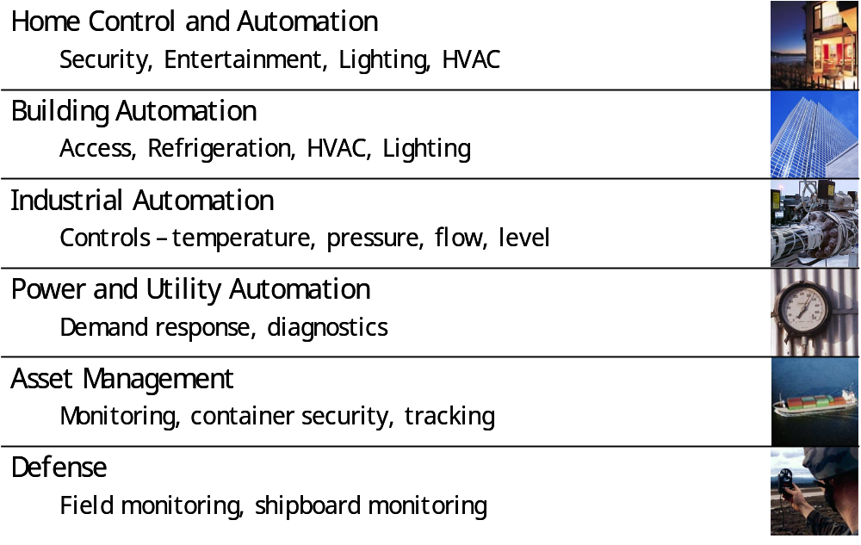
Introduction
What is Wireless Sensor Network?
  Ad-hoc wireless network of large number of nodes
  Each node equipped with sensor(s) to detect a physical phenomenon (e.g. Light, Sound, Temperature, or Motion)
  Applications Include:

Slide 4
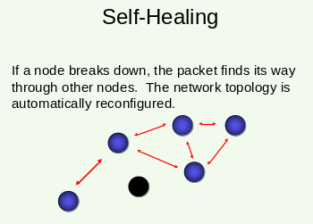
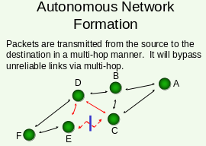
Introduction (2) – Key Features
Reliable
  Self-Healing MESH Network
Scalable
  Supports up to 65,536 nodes by specification
  Practically max at 3,000 node
Long lasting
  Low power consumption
  Current draw of MicaZ:
  <15-µA sleep mode, 8mA active mode, and 19.7mA receive mode
Globally Deployable
  802.15.4 MAC/PHY supports 2.4GHz, 868/915MHz frequencies
➔Easy Deployment
  Hubs, Routers not needed
  Autonomous Network Formation

Slide 5
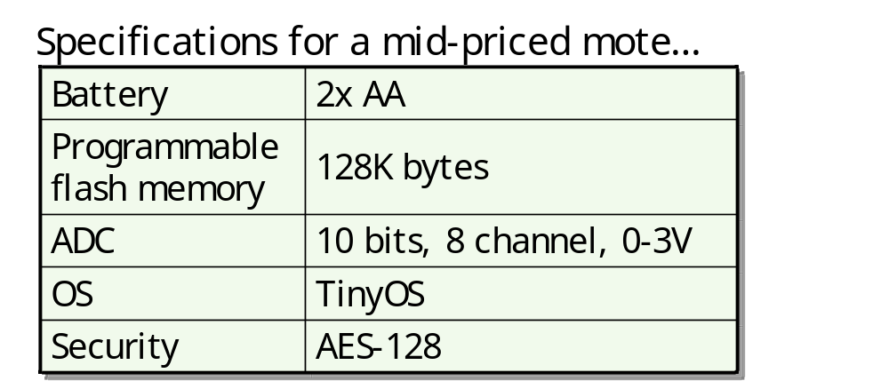
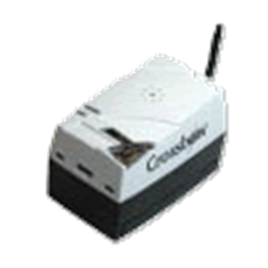
Introduction (3) - Limitations
However, due to cost, nodes have limited resources
  E.g. Energy, Memory, Computational Ability

Slide 6
More Limitations
Developmental Limitations
Developing with Limited Resources
  Difficult for developers to gauge the actual resource usage
  i.e. What is the trade-off between my code’s complexity and battery lifetime?
Visualizing Highly Dynamic or Heterogeneous Network
  Difficult time visualizing and adjusting design to fit different platforms / devices
  i.e. Different application on different nodes
Re-implementing Code
  Frequent reimplementation of similar code or copying and pasting code
  Same code programmed onto several nodes manually
  Difficult to debug due to error being manually propagated
[1] Romer, K. “Programming Paradigms and Middleware for Sensor Networks.” Institute for Pervasive Computing, ETH Zurich
[2] Morron, P. J. “Middleware Approaches for Sensor Networks.” University of Stuttgart, IPVS, Distributed Systems Group

Slide 7
Middleware Overview
Ideal Goals
  Abstraction Support
  Hide complexity & provide overall view
  Efficiency
  Energy efficient & resource-friendly
  Programmability
  Configuration/reconfiguration support
  Adaptability
  Supports algorithms that adapt to change
  Scalability
  i.e. Works even with large number of nodes
  Topology
  Optimal network configuration
  Security & QoS
App
Middleware
OS
Platform

Slide 8
WSN Middlewares
Type | Description | Example
“Classic” | Hide the complexity of network communication and data transfer | Impala, TinyLime, EnviroTrack, Mires, Hood
Data-centric | Provide the abstraction of the network as a database | Cougar, TinyDB, DSWare, SINA
Virtual Machines | The network is a collection of code interpreters that take care of running programs/scripts | Mate, Smart Messages, Agilla, SensorWare
Adaptive | Focuses on adaptability (remain rather complex) | MiLAN, AutoSec, TinyCubus

Slide 9
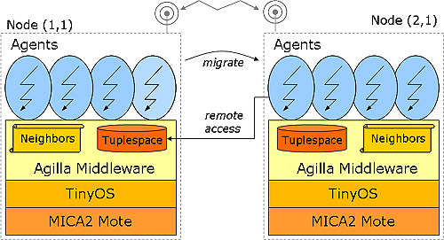
Agilla Middleware Architecture
Node identification
  2D matrix
Autonomous Agents
  Access local and neighbor tuplespace
  Migrate code and state (but not tuplespace)
  Communicates indirectly between agents via tuplespace datum
Tuplespace
  Local, shared data memory
Neighbor List
  Contains address of one-hop nodes

Slide 10
Agilla Features
Node can support multiple agents
  i.e. multiple applications
Agents can probe neighbor tuplespace for datum via pattern matching
  (i.e. {type, value}, wildcards supported).
Datum probe can be reactive
  (i.e. notify when such datum has been sampled. Publisher-subscriber relation)
Agents can be injected into pre-existing network
  → dynamic “retasking” of existing WSN
+ Inherent advantages of agents
  Reduce network load, overcome network latency, asynchronous and autonomous, heterogeneity, distributed information retrieval

Slide 11
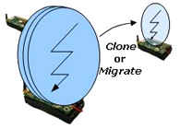
Agent Migration
Typically one-hop process based on neighbor info
Segments agent code into <41byte packets to avoid message loss
Employs timeout and retransmission
Addresses destination nodes by location, e.g. (1,1)
Uses Maté virtual machine for remote, in-network reprogramming (http://www.cs.berkeley.edu/%7Epal/mate-web/)
Has option of clone or migrate

Slide 12
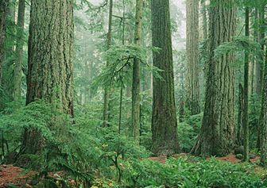
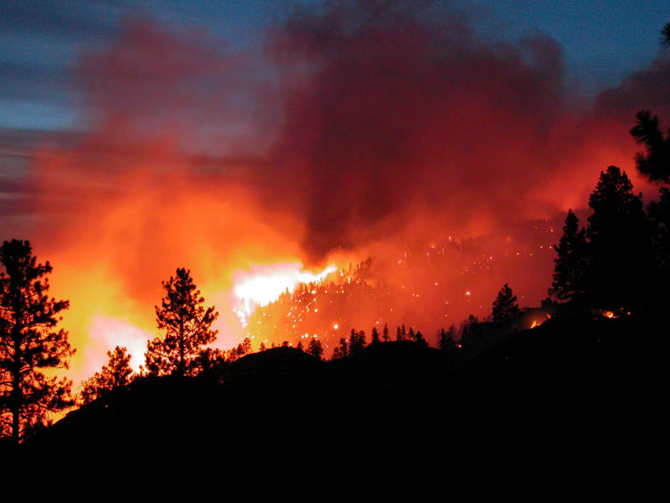
Example
Scenario:
Forest monitoring application using Agilla mobile agent middleware to monitor forest habitat…
In the hot summer months, a forest fire occurred…

Slide 13
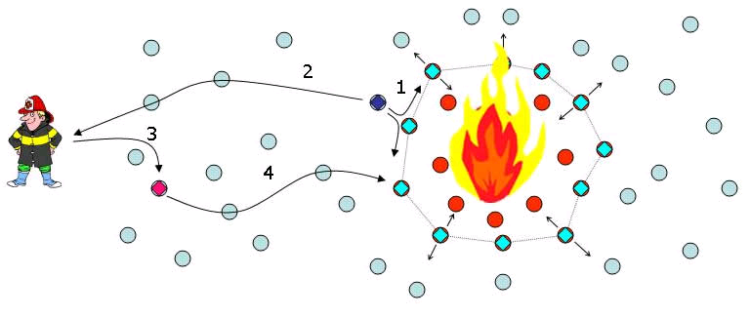
Example
Fire Detection
Fire detection agent detects fire and clones itself. The clone transforms itself into a fire tracking agent that repeatedly clones itself until a perimeter has been formed.
A notification is sent to a firefighter notifying him of the fire’s location
The firefighter injects a guidance agent into the network that leads the firefighter along a safe route to the fire.

Slide 14
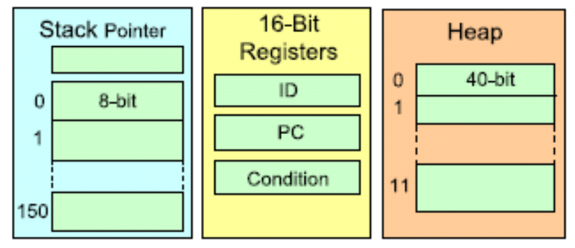
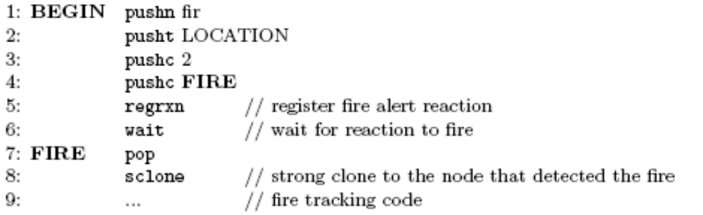
Example Code
Lightweight FIREDETECTOR Agent Spawns FIRETRACKER Agent upon fire detection
FIRETRACKER Agent Code:
  Line 1-6:
    Register reaction sensitivity to “fir” tuple
    Branch to FIRE upon reaction
  Line 7-8:
    Clone self at the node that detected the fire
Constant 2 to indicate the datum is {fir, LOCATION}

Slide 15
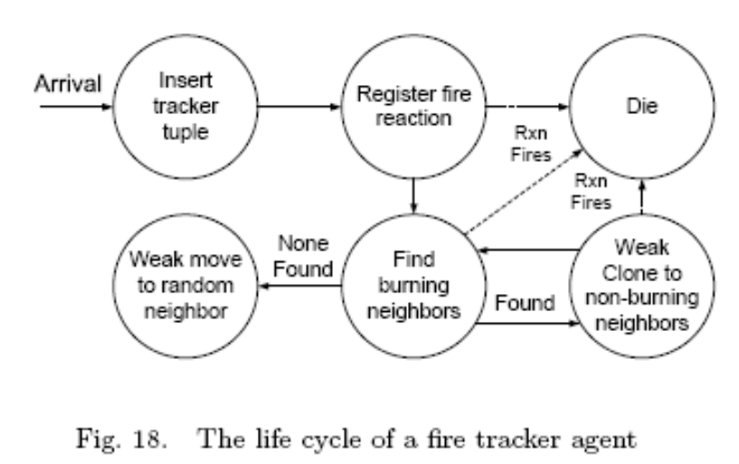
Example Agent Lifecycle
Register reaction
Repeatedly check whether any neighbour is on fire
NO - Weak move to random neighbor and repeat OR
YES – Tracking mode
  Determine location of all neighbours on fire
  Weak clone to neighbours not on fire and not running tracker agent
  Periodic checking of neighbours in danger of catching fire to adjust fire perimeter

Slide 16
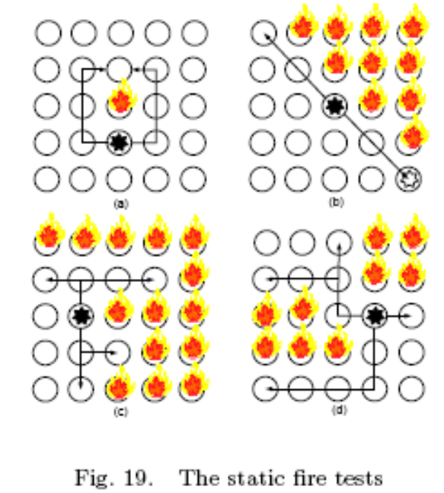
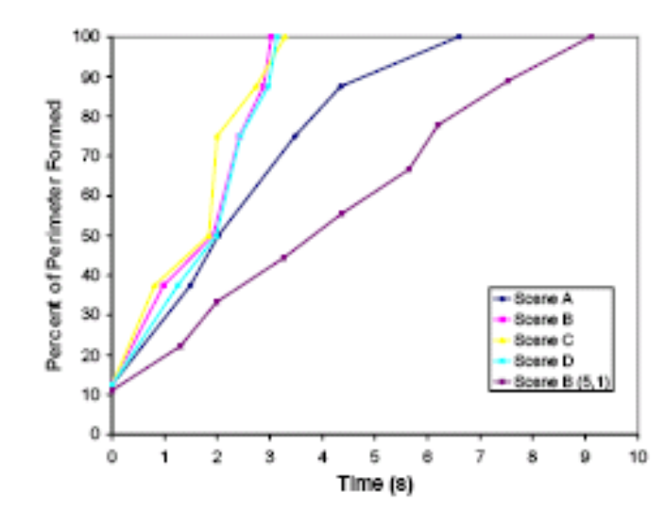
FireTracker Result - Static
Fire does not spread
5x5 Grid
100% perimeter always eventually formed
Starting location of FireTracker agent affects efficiency
(A)
(B)
(C)
(D)
Case (B) with FireTracker
starting at (5,1) location – 9s
Case (B) with FireTracker
starting at (3,3) location – 3s

Slide 17
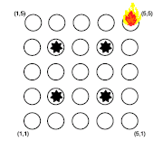
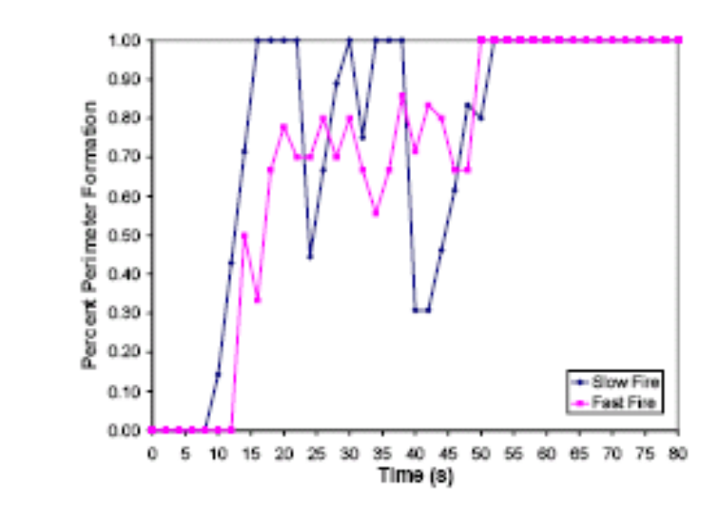
FireTracker Result - Dynamic
Fire spreads
5x5 Grid
100% perimeter always eventually formed
Able to form perimeter for both slow and fast fires
Initial Perimeter
50s
Initial Perimeter
15s
➔ Slow Fire
➔ Fast Fire

Slide 18
Conclusion - Agilla Limitations
Necessary Grid Deployment
Instruction Set Programming
Installation is time consuming and installation documentation has not been maintained
  Ex. Requires Java Run-time 5 but indicated 1.4 (old documentation)
Experimenting with the latest version yet to produce any results.
  i.e. Agent injection failure
➔Still an Immature Middleware⬅

Slide 19
Questions / Comments
Discussions

Slide 20
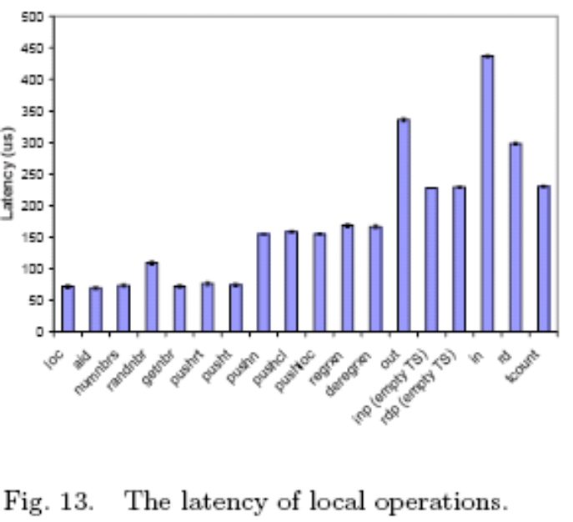
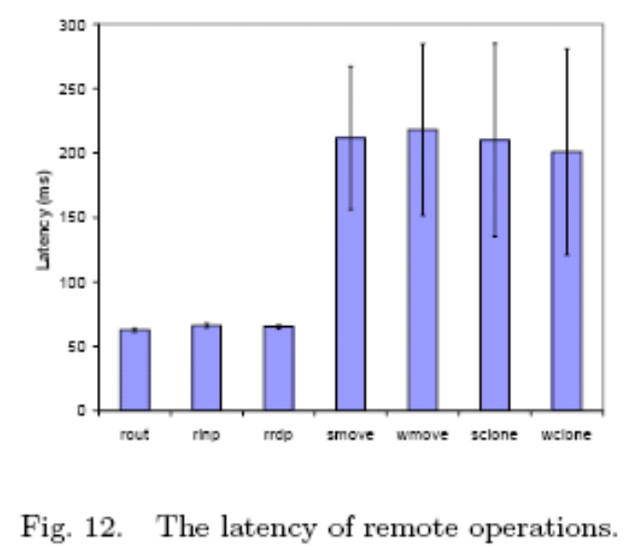
Latency

Slide 21
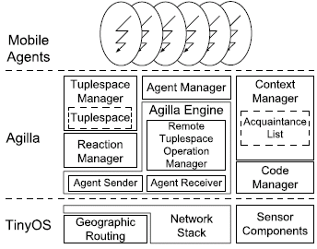
Detailed Architecture

